Slide 1
Type conversion & Vectors

Slide 2
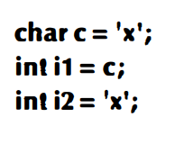
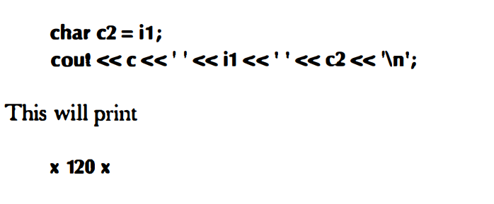
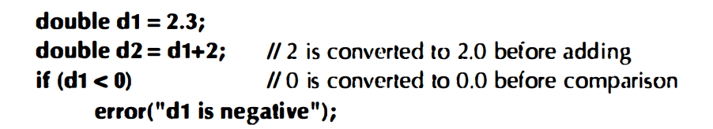
TYPE CONVERSION: SAFE CONVERSION
Here both i1 and i2 get the value 120, which is the integer value of the character 1X1
SAFE CONVERSION
bool to char
bool to int
bool to double
char to int
char to double
int to double

Slide 3
UNSAFE [THE VALUE STORED DIFFER FROM VALUE ASSIGNED]
double to int
double to char
double to bool
int to char
int to bool
char to booL

Slide 4
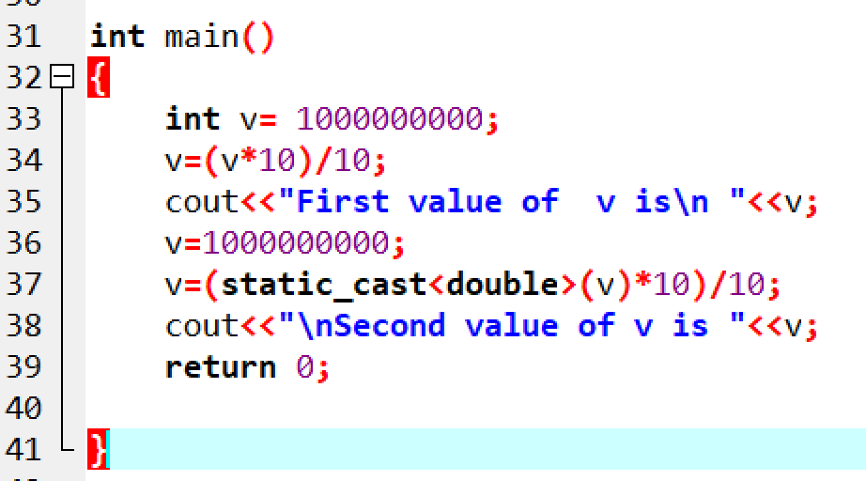
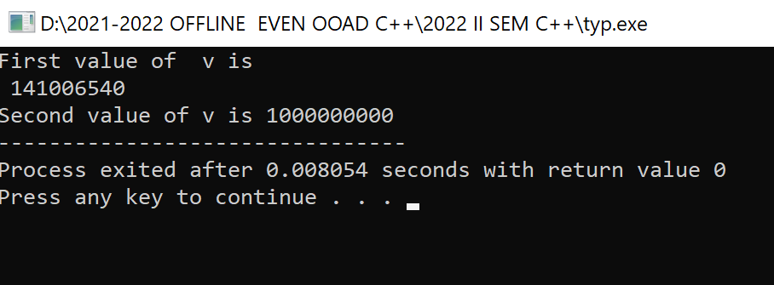
Explicit conversion-static_cast

Slide 5
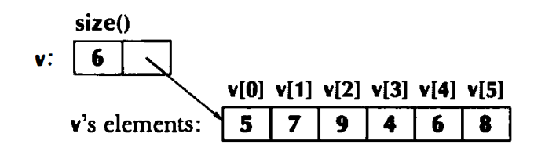
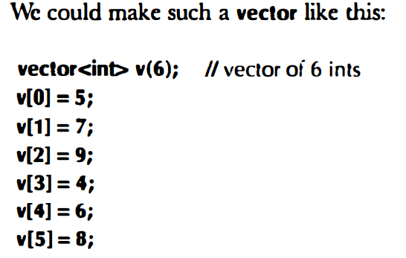
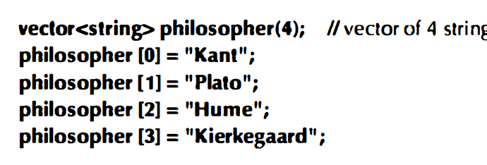
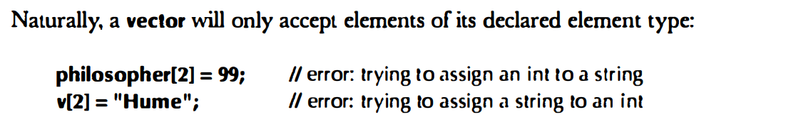
A vector.
is simply a sequence of elements that you can access by an index

Slide 6
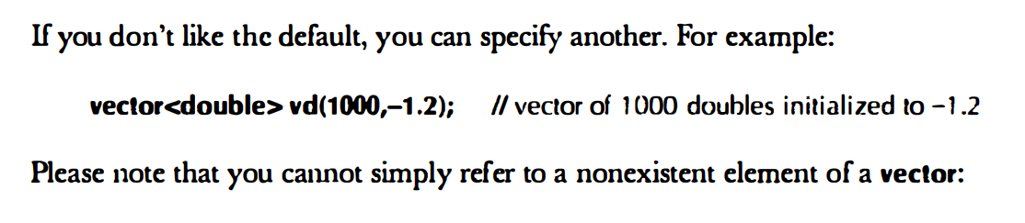

Slide 7
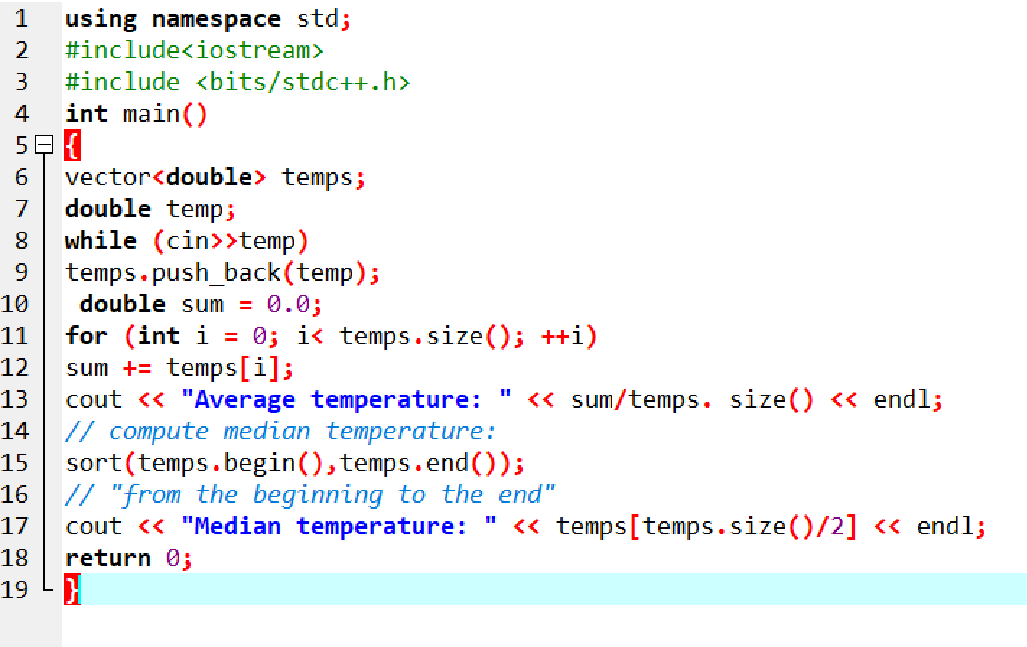
A numeric example Compute mean and median temperatures

Slide 8
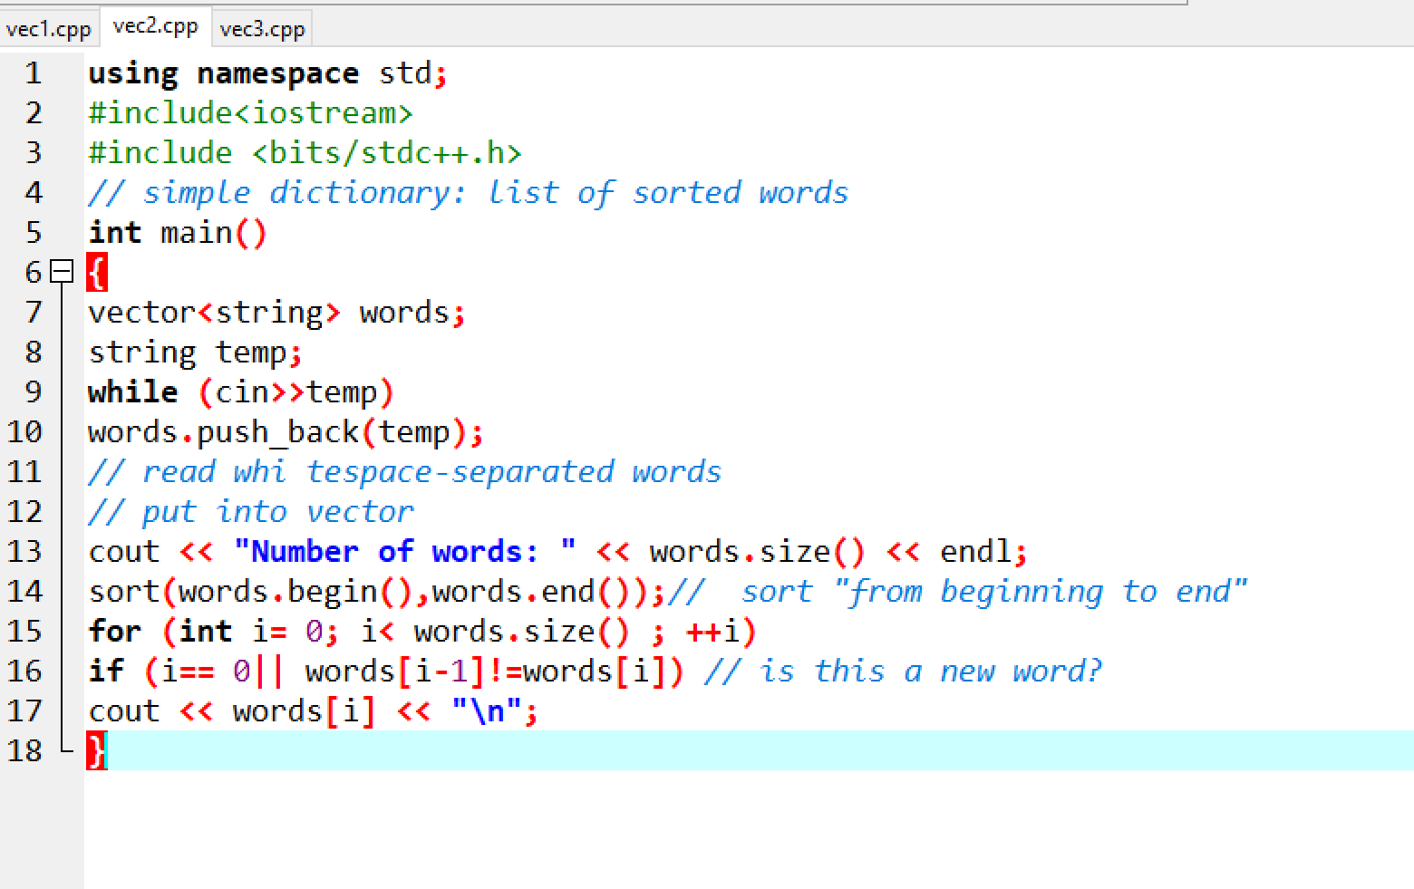
A text example

Slide 9
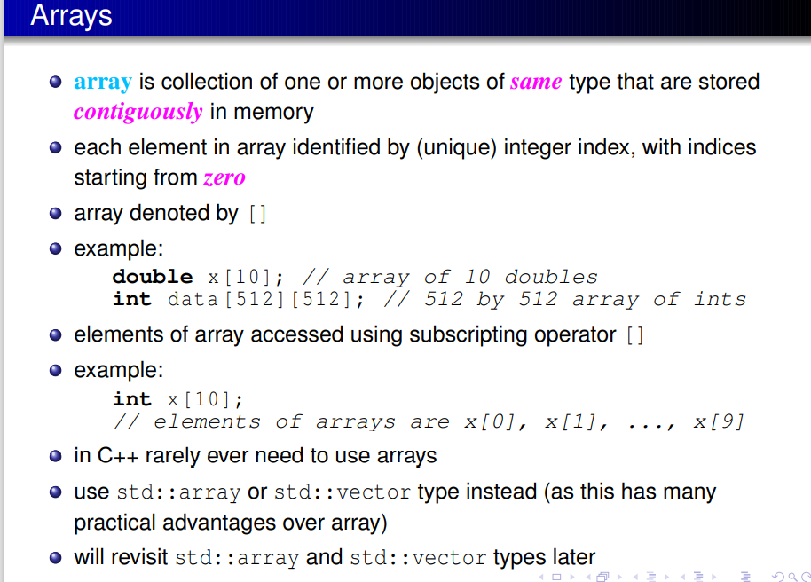

Slide 10
